Slide 1
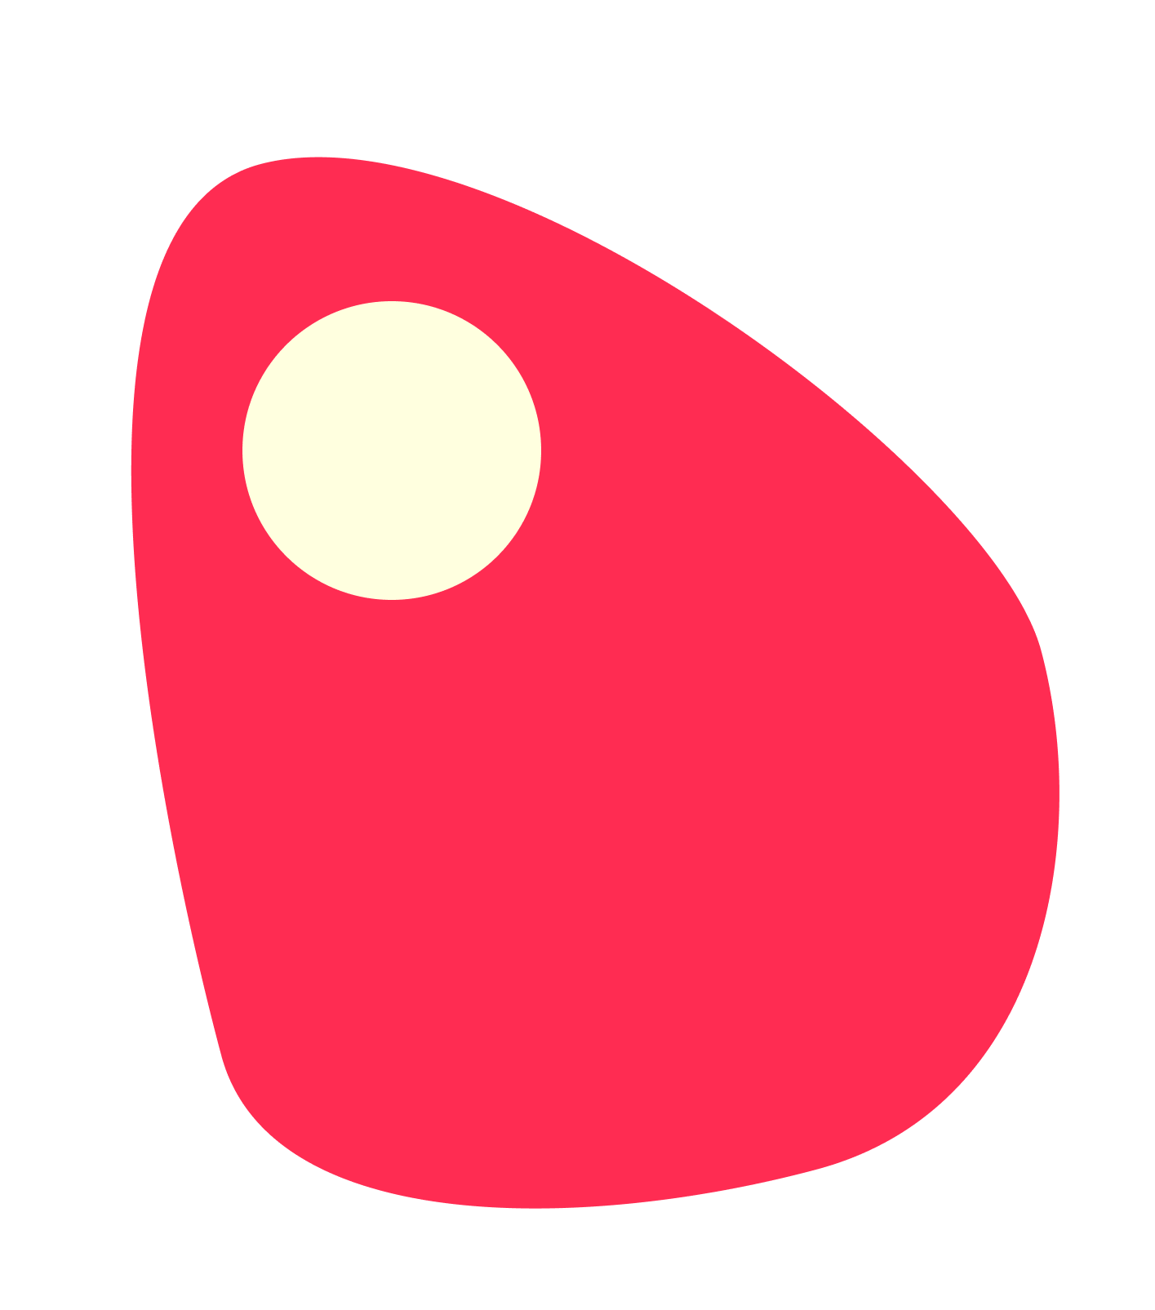
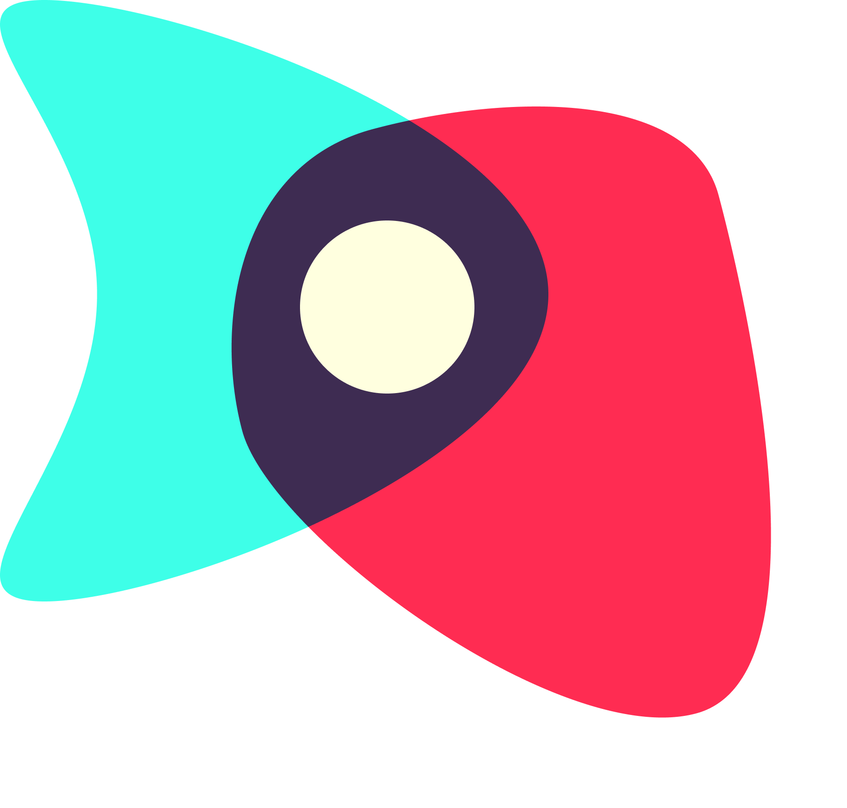
Digital Democracy:
First Task Hi-Fi Prototype
Sharewaves
Garrick F. | Gen S. | Grace W.
Notes:
New title slide

Slide 2
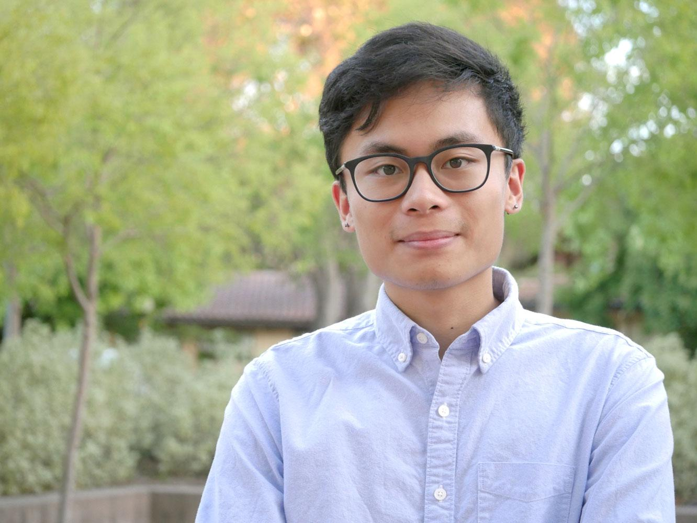
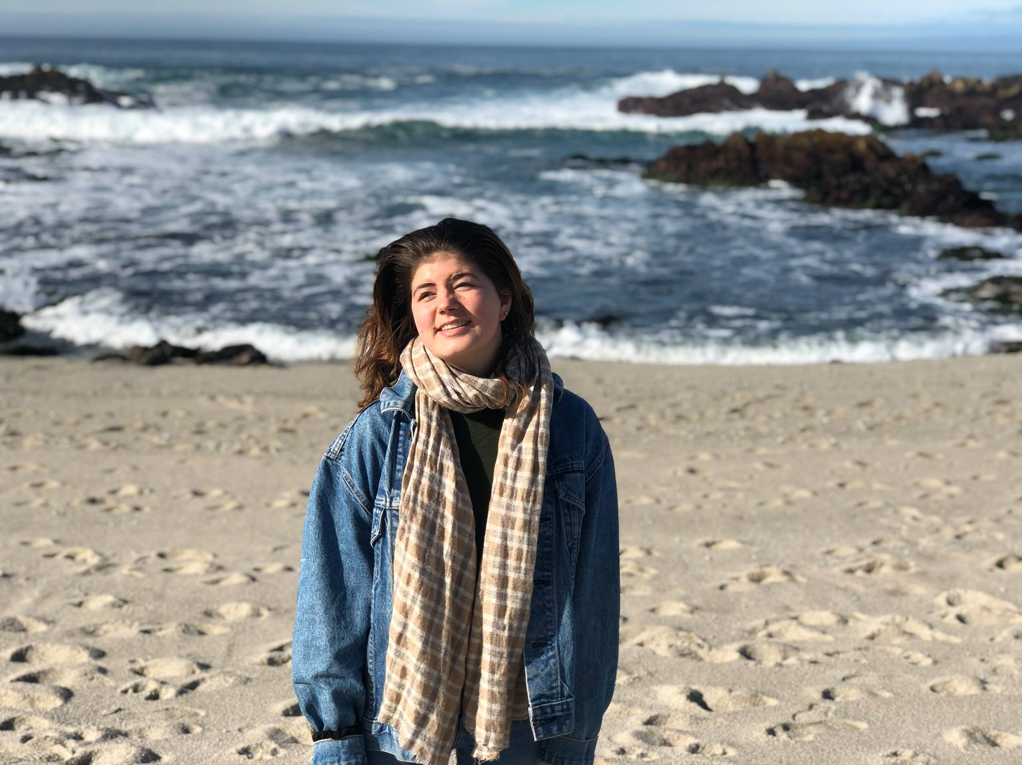
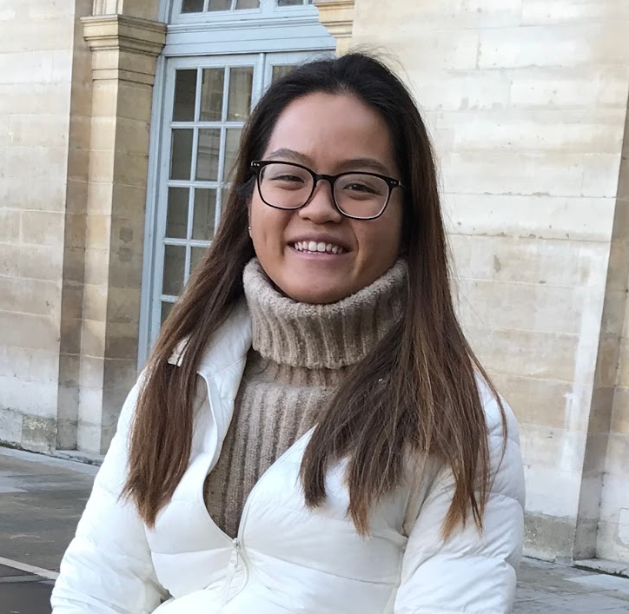
Garrick
Gen
Grace
Coterm, CompSci
ran out of facts
Senior, SymSys
flamed for liking honeydew
Senior, Econ
loves filet-o-fish
Our mission is to help people harness the activation energy from reading and sharing news into getting involved with political issues in their own communities.
Notes:
Introduce team and mission

Slide 3

The Problem
Online communities, discourse, and news divide and isolate people, leaving them feeling hopeless, unenergized, and without clear ways to participate in politics.
Notes:
Introduce problem (There are already ways people read and share news out there, but in our needfinding and EP testing we saw people who were unenergized and feeling hopeless. When you read the news a common feeling you get is “what can I do about it”)

Slide 4
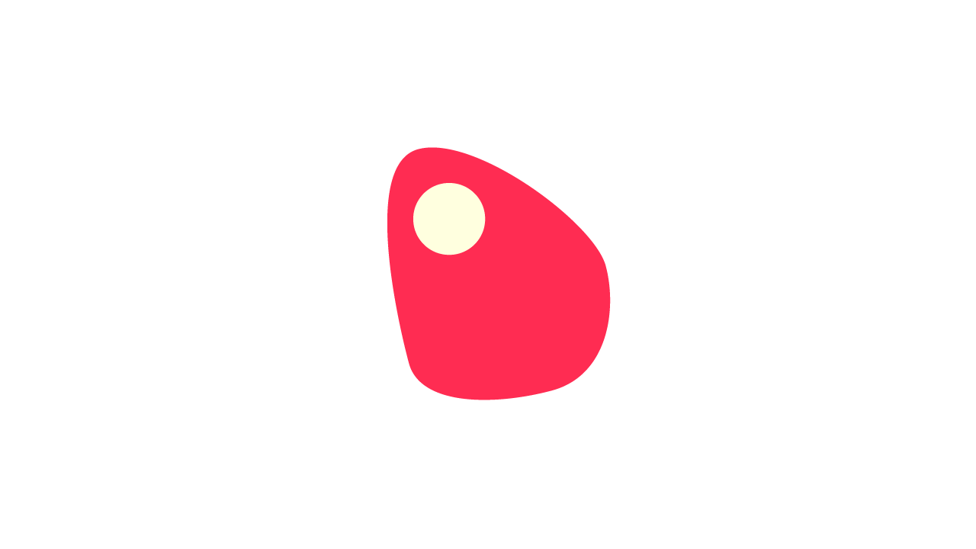
The Solution
We provide a platform for people to rally around stories they care about, see people like them, and get offline—sparking political conversation and action in their communities.
Notes:
Introduce solution (We are the thing you can do about it. idea is to get offline!!!)

Slide 5
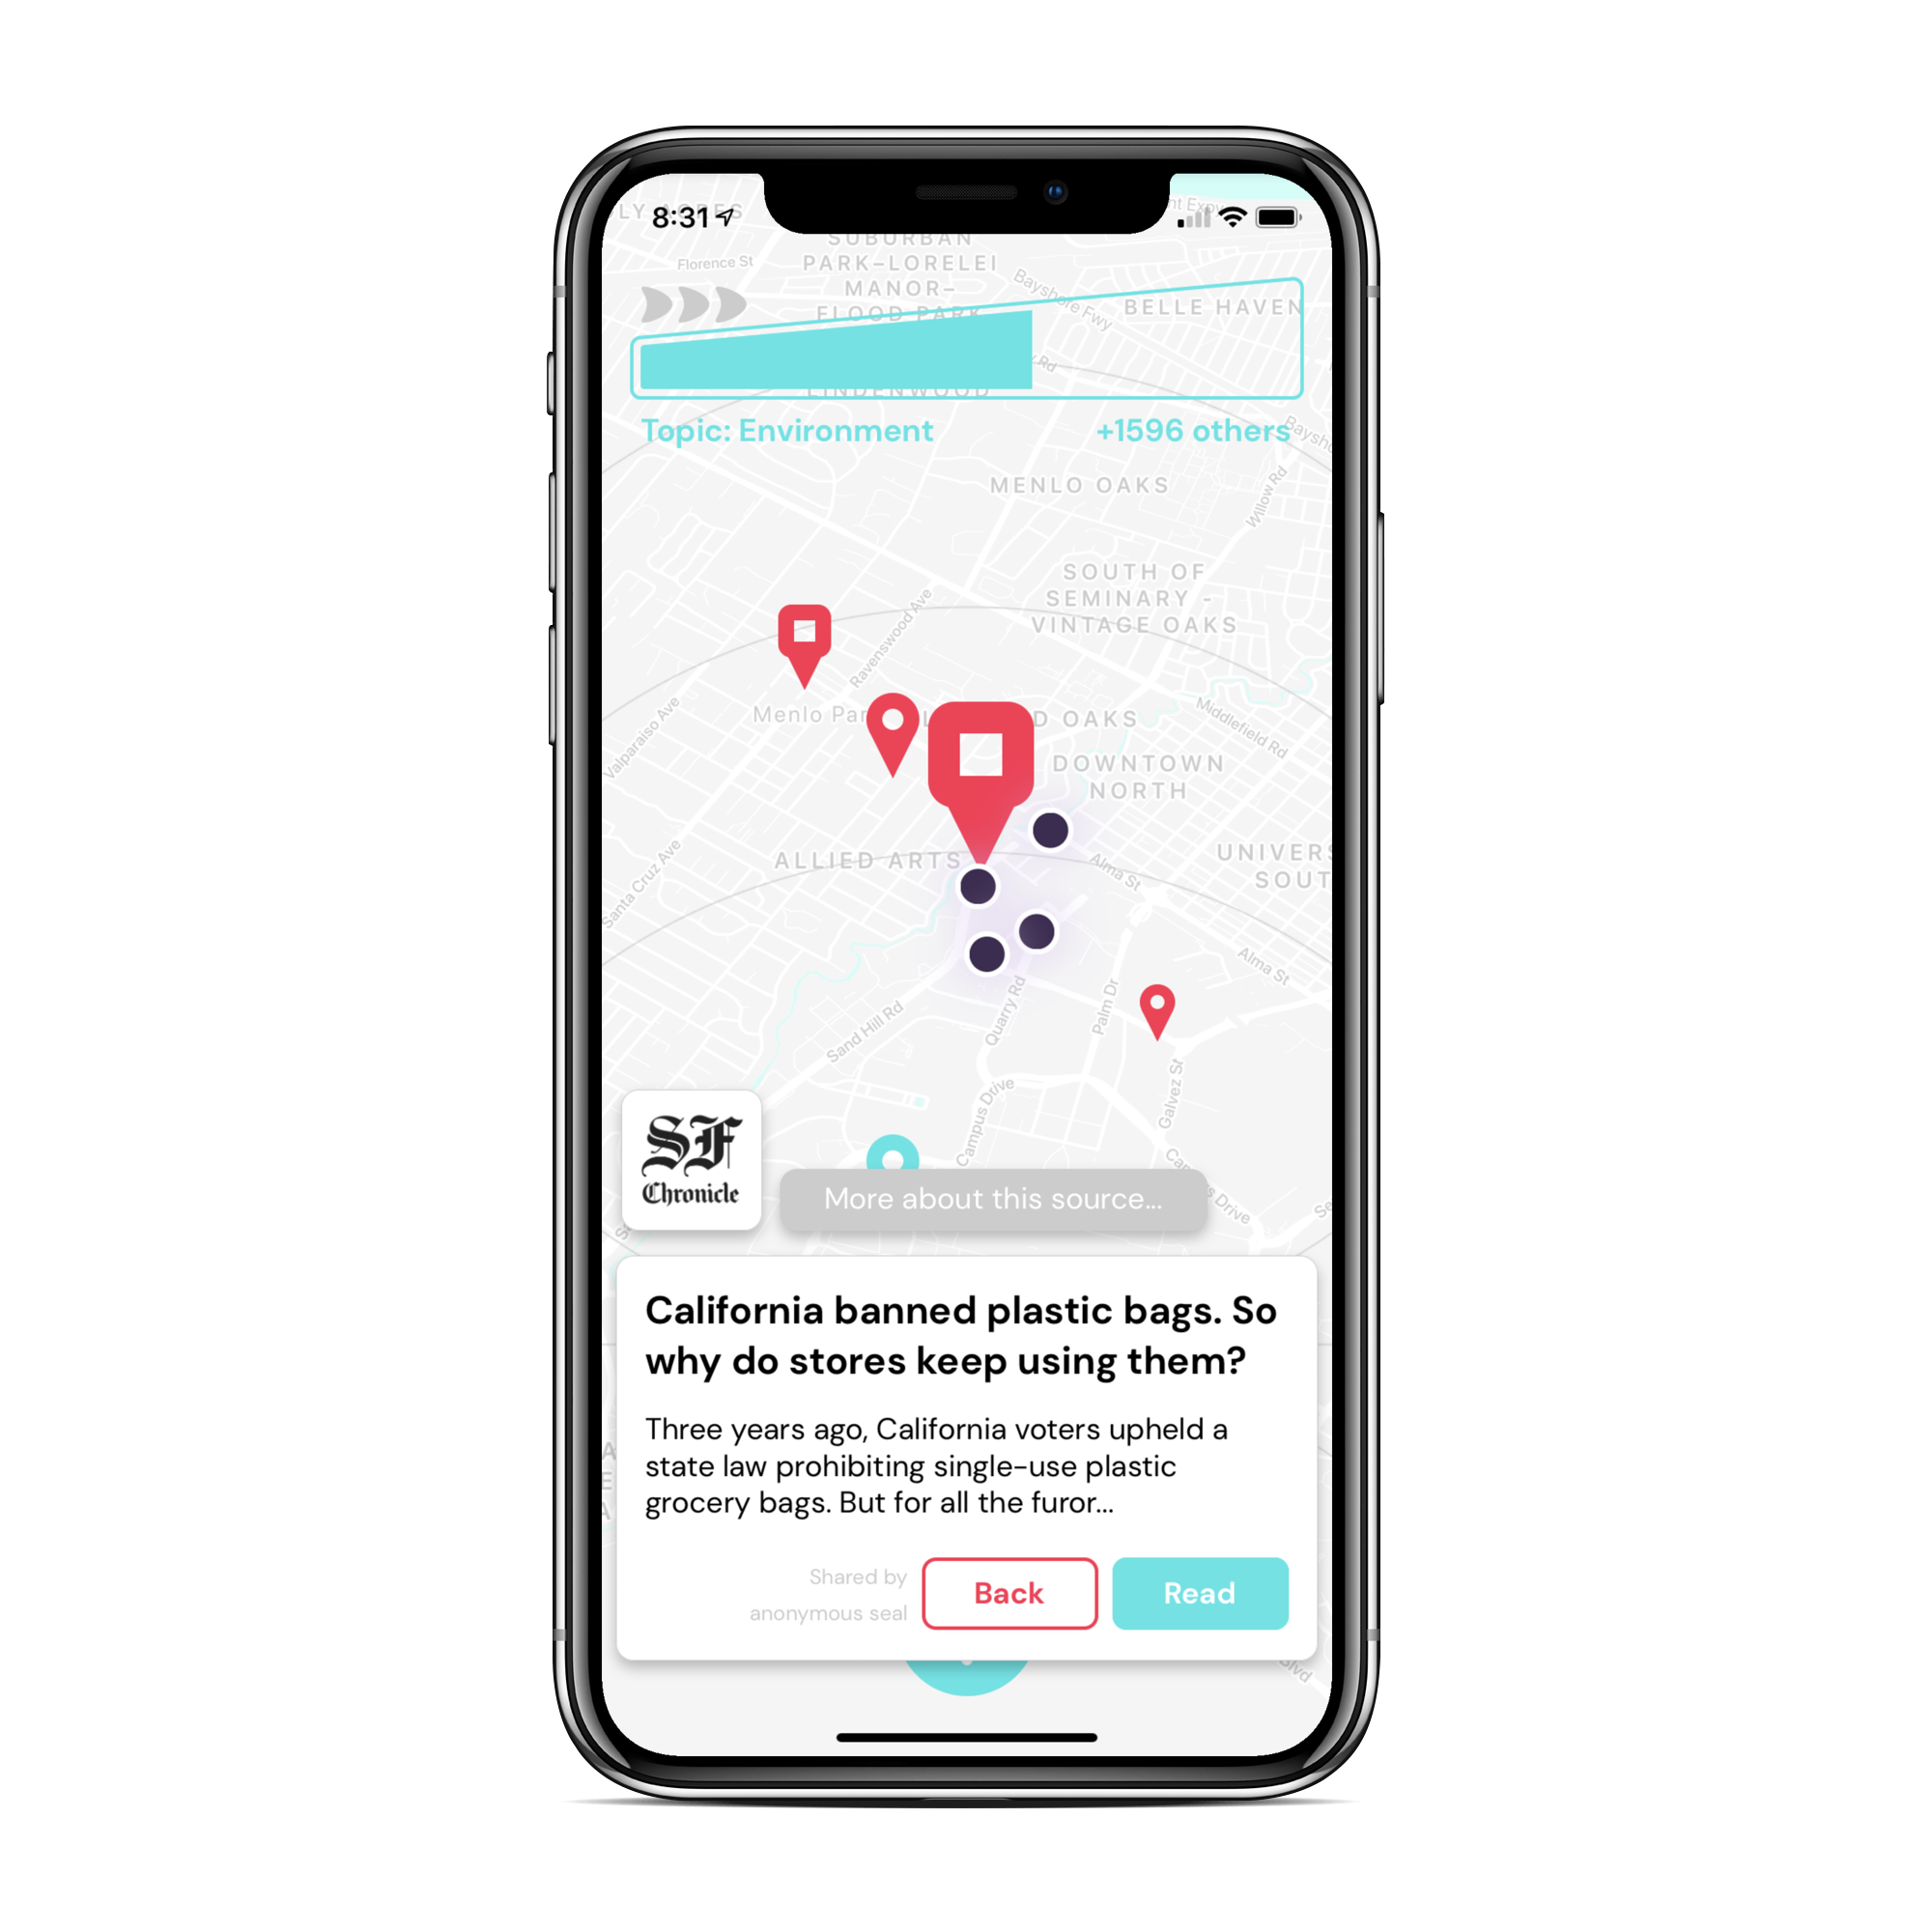
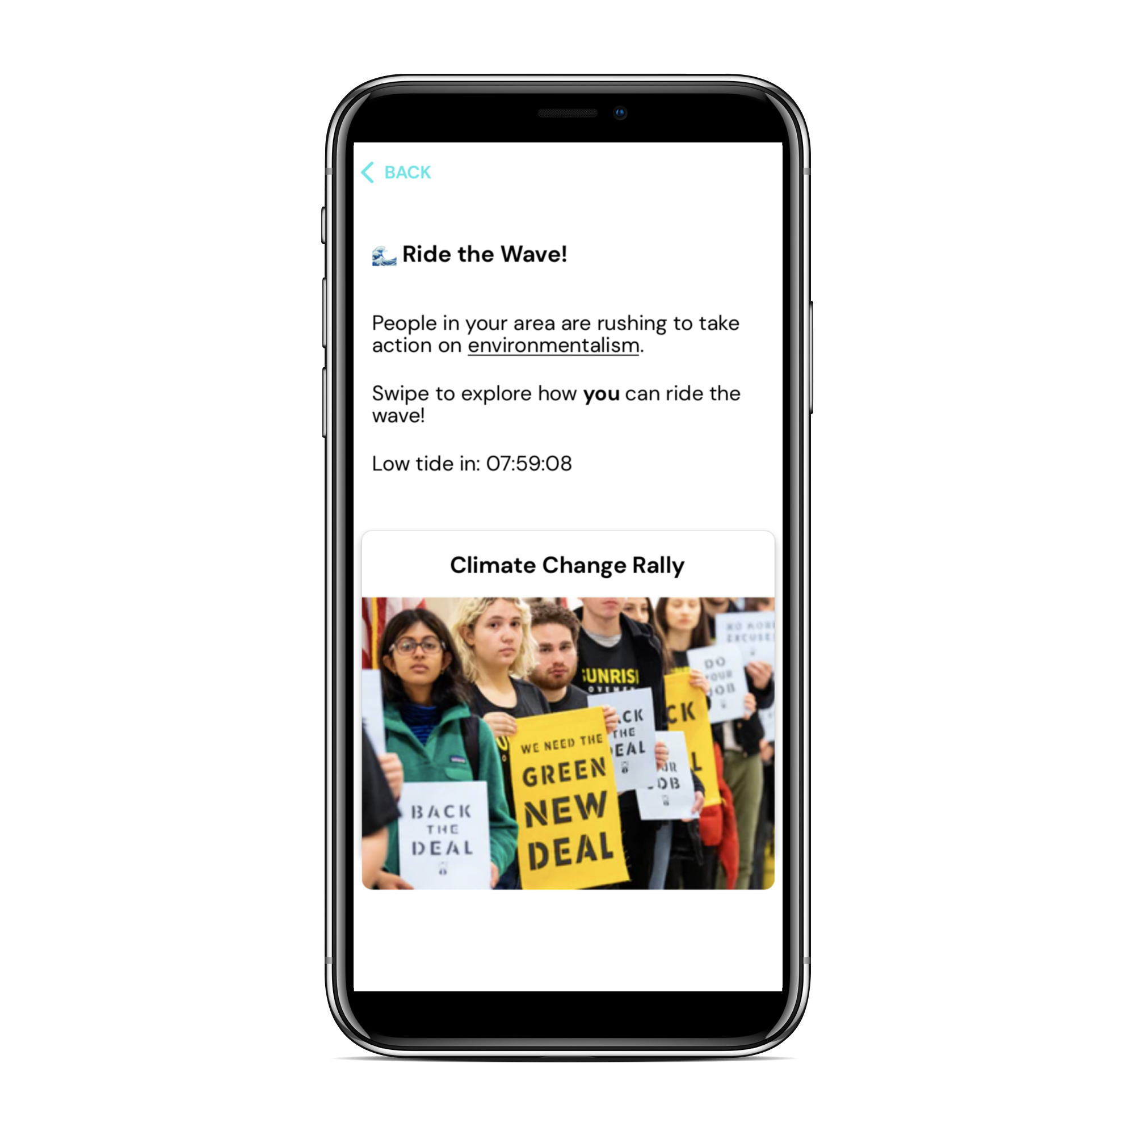
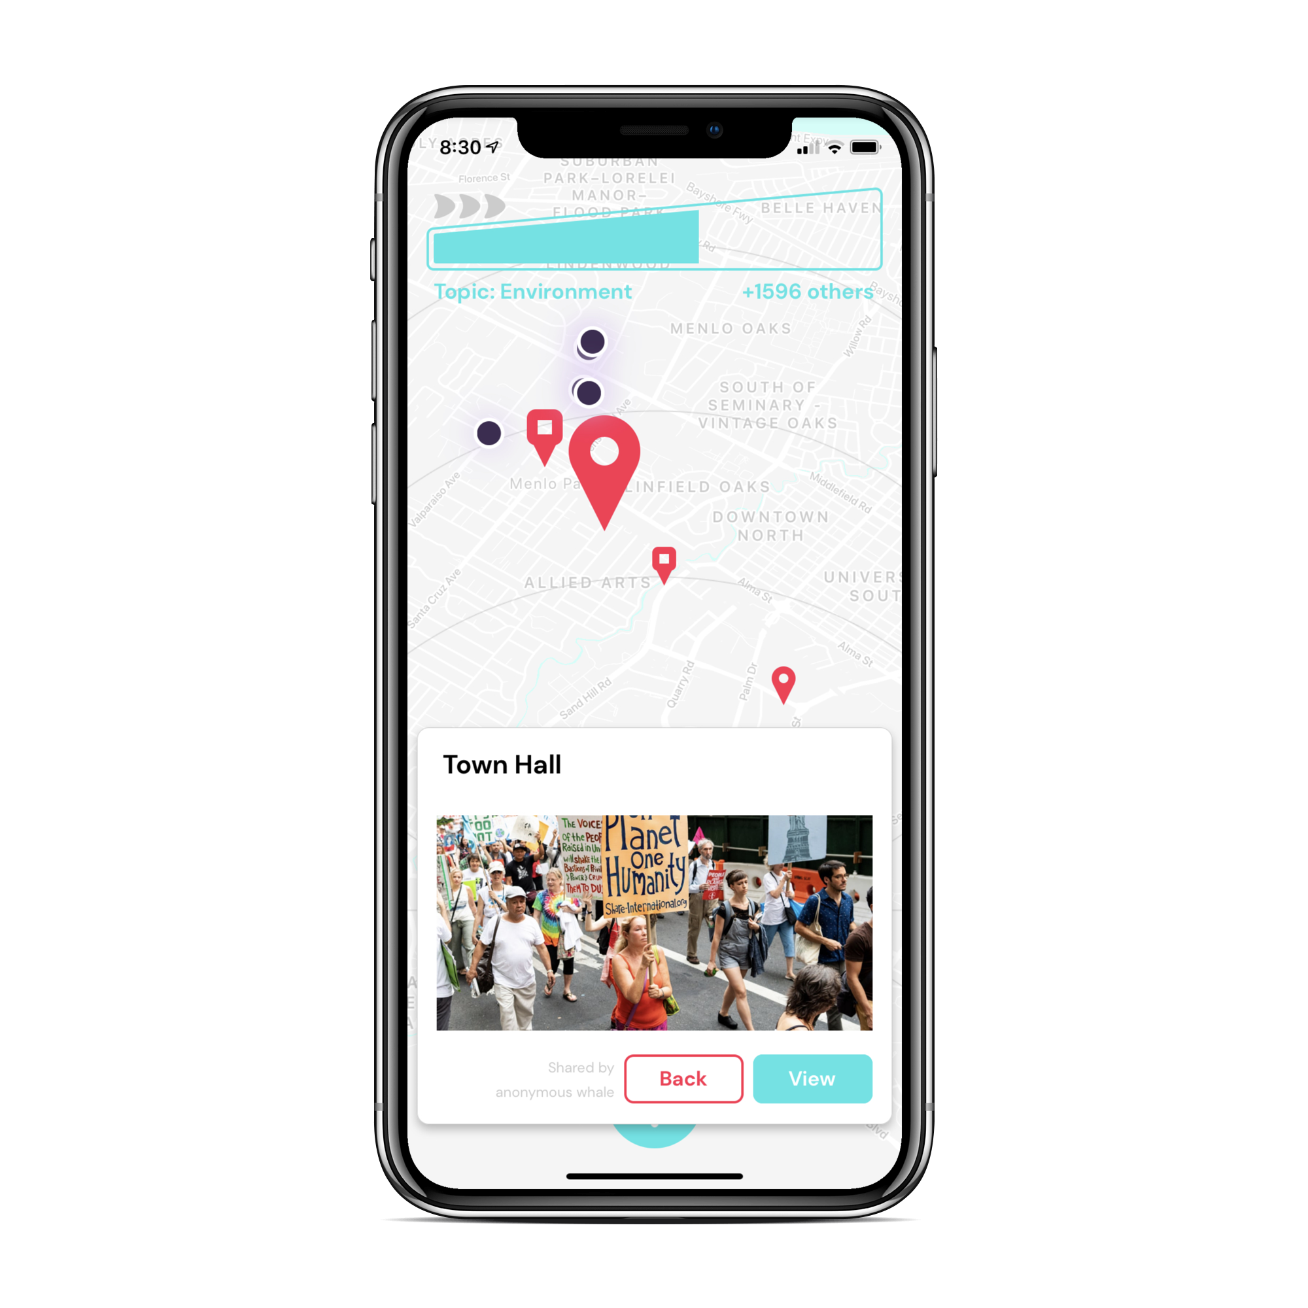


Notes:
Here’s our name and value proposition. With our app, you can see the changes happening in your communities and contribute to it, and it’s just an extra no-frills layer on top of the news-reading experience.

Slide 6
Heuristic Evaluation Feedback & Overview of Revised Design
Feedback themes:
Unable to go ‘back’ and cancel actions (user control & freedom)
Issues understanding features (trending bar, ‘Ride the Wave’ action, wave metaphor)

Slide 7
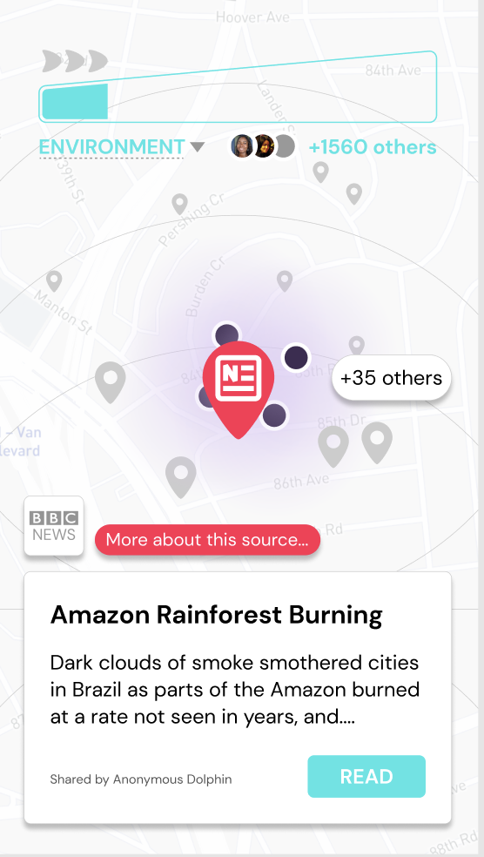
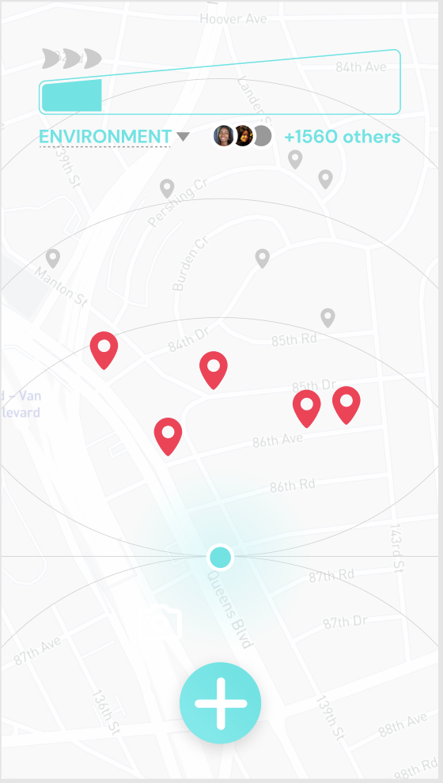
Feedback: users found it difficult to go back once a pin was selected.
Solution: users can click on the map to go back and unselect a pin. Explicit back button in the works for hi-fi

Slide 8
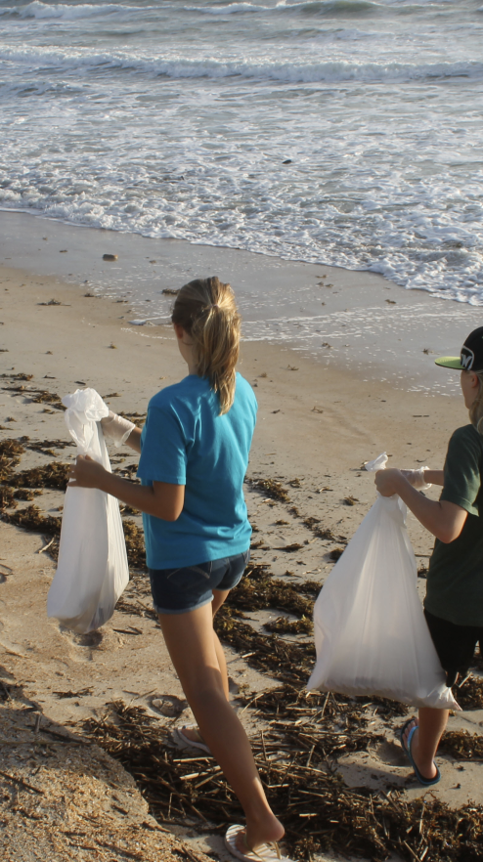

Feedback: users were able to go back to the map once they clicked on a video.
Solution: added a close button to the video/media screen.

Slide 9
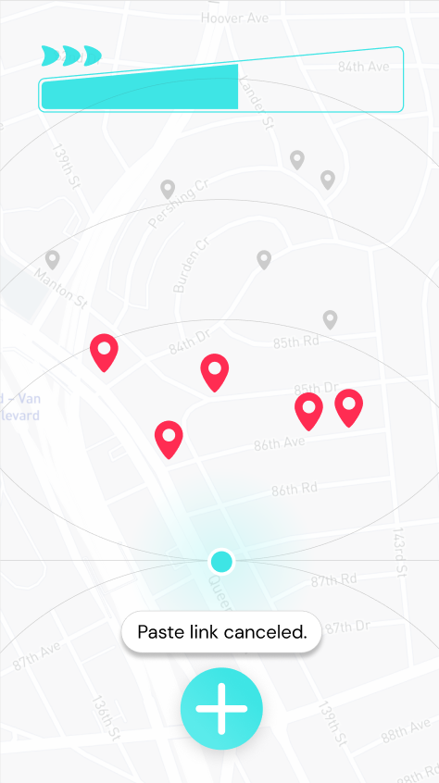
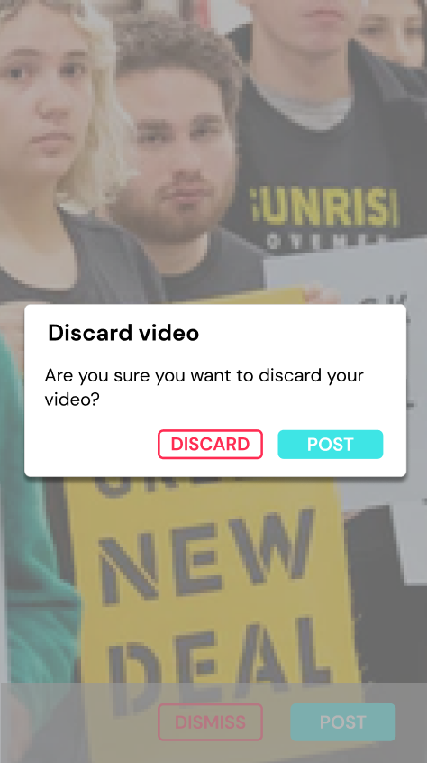
Feedback: Users wanted to confirm negative actions (e.g. discarding a video or link.)
Solution: added a pop-up to the discard video, added a toast for discarded links

Slide 10
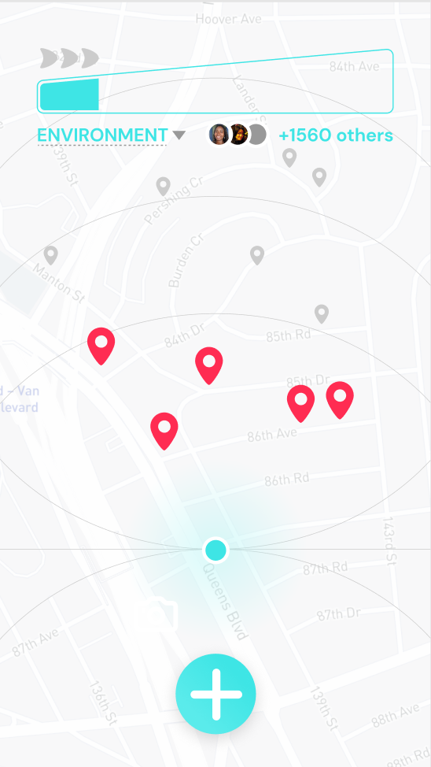
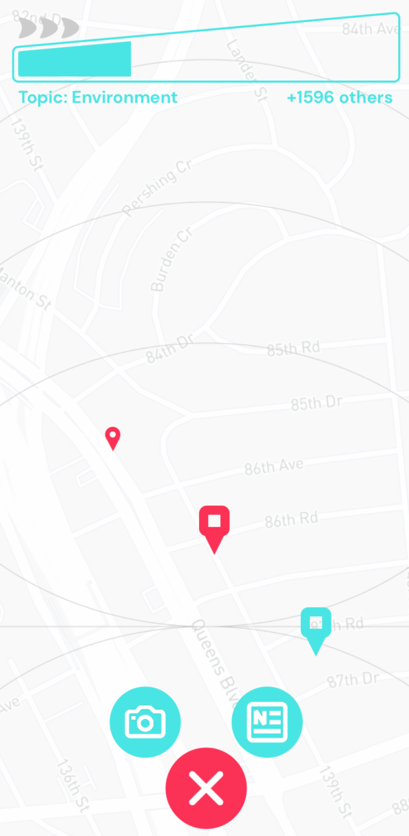
Feedback: Users wanted to distinguish types of pins and content creator on the map.
Solution: added rounded pin for video, rounded square pin for news and used color to distinguish between “mine” and “yours” (i.e. who posted the content)

Slide 11
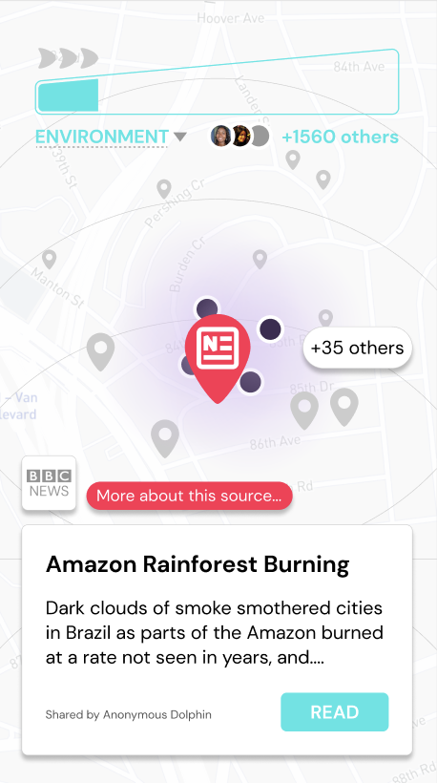
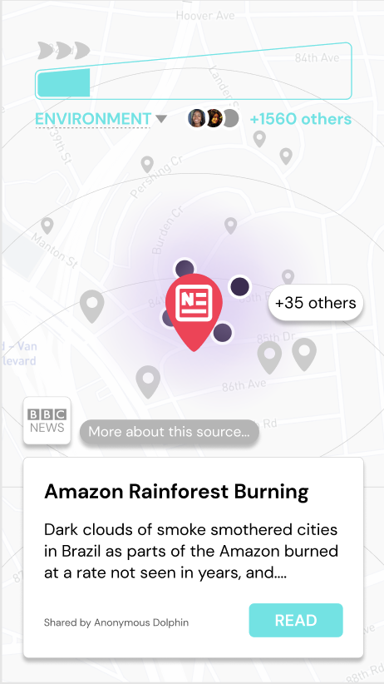
Feedback: the ‘More about this source’ was distracting.
Solution: changed the color of the ‘More about this source’ button to a more neutral color.

Slide 12
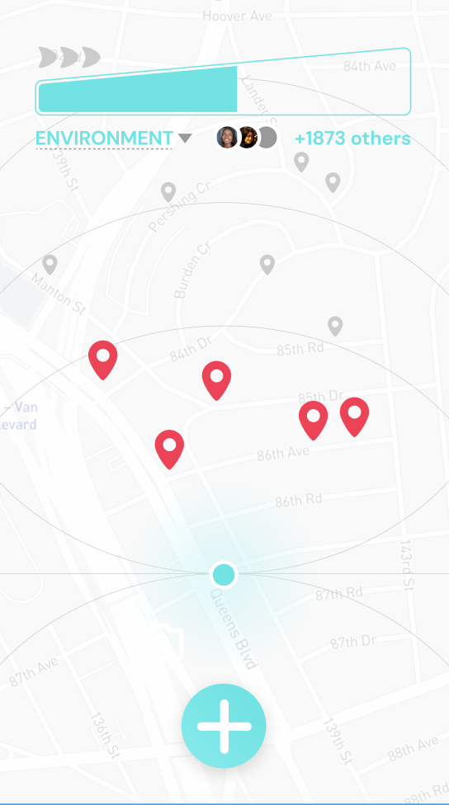
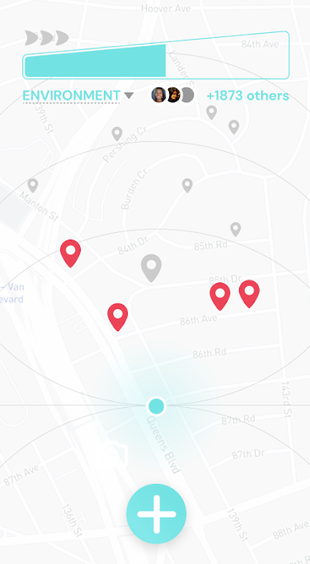
Feedback: the map didn’t update to show when the pin had already been read or watched.
Solution: the pin turns smaller after the user has viewed/read the story.

Slide 13
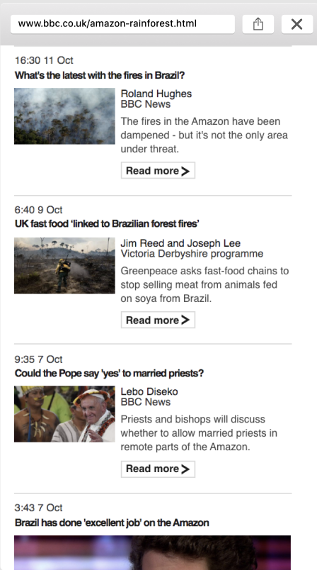
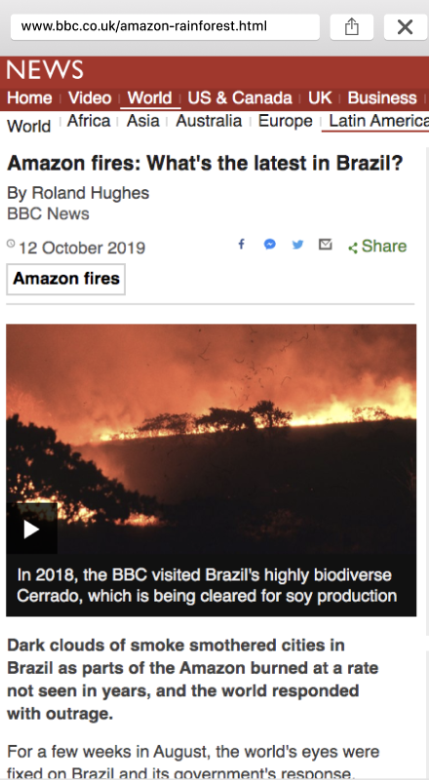
Feedback: the image used to represent a news article was confusing because it wasn’t congruent with the pop-up; users were also expecting to see an article.
Solution: changed the ‘website’ displayed to an article that was more relevant to the initial pop-up.

Slide 14
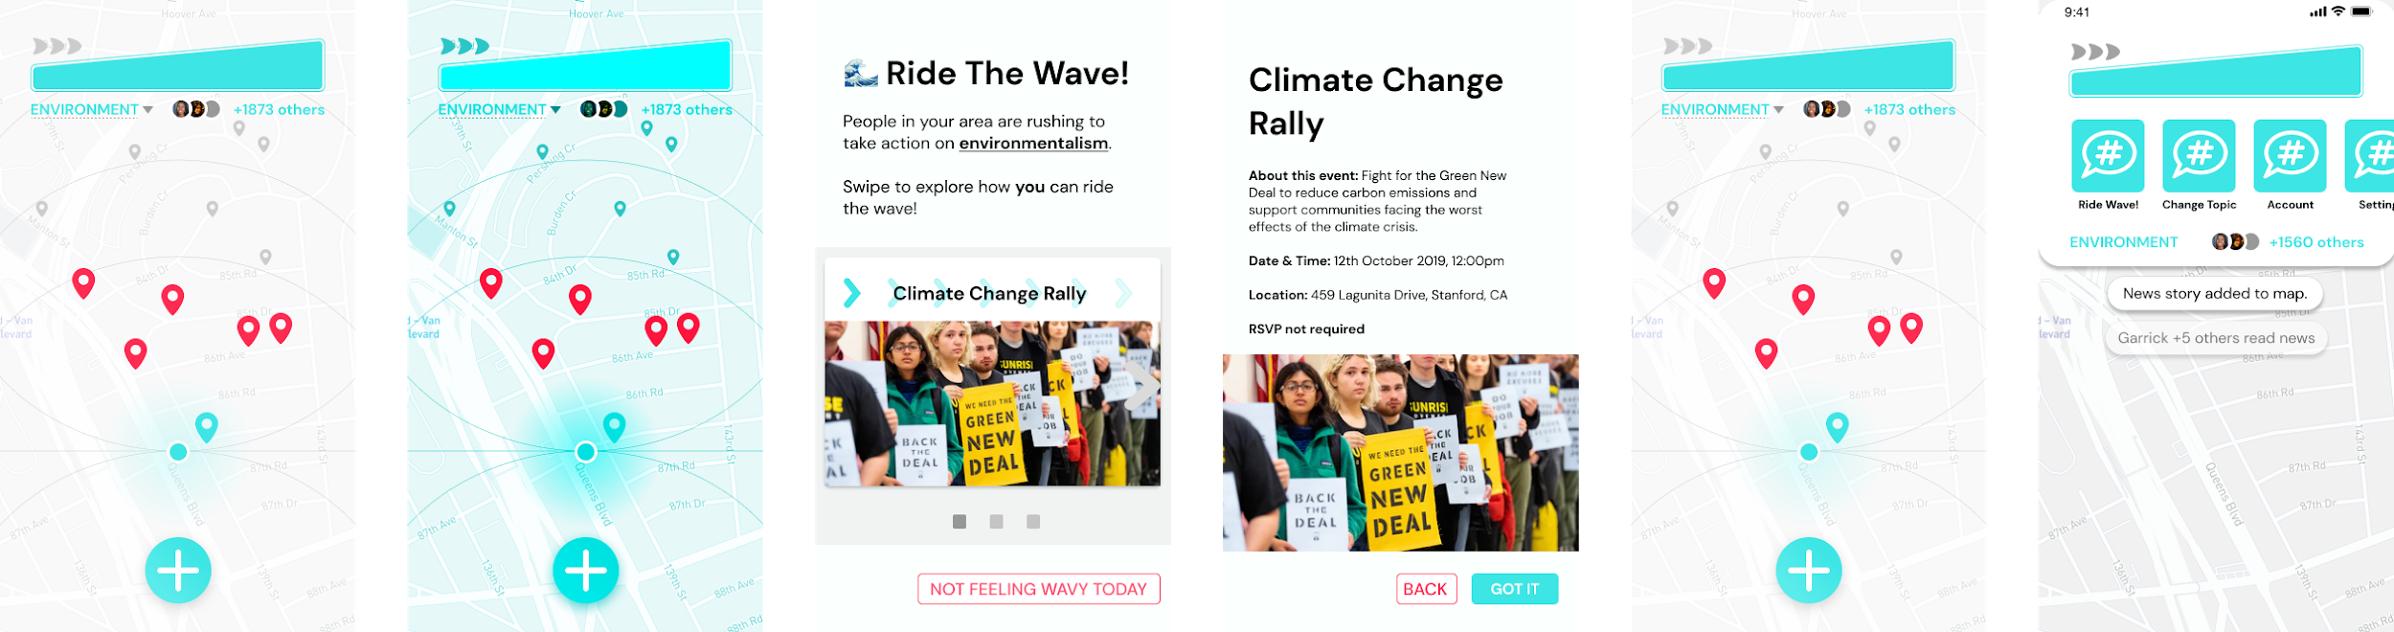
Feedback: Wave icon appeared clickable, no way to go back to see wave events, wish for context/textual menus and information about how actions are filling the pressure meter
Solution: Wave icon grayed out, add menu with option to go back and see active wave events, provide mini-feed underneath pressure meter

Slide 15
A few more comments:
Visibility of system status (Severity 3): nothing indicates how the map shown is determined. How far does the map go?
We want to emphasize local stories, but are considering allowing the user to scroll and explore areas by moving the map.
Aesthetic and minimalist design (Severity 1): UI can be obstructive to the view of the map and pins, ex) the “+” button is pretty big.
We experimented with a smaller one, but felt like it would be too difficult to click on and interact with. We want to be clear about what elements the user should interact with.

Slide 16
Confusion on ‘profiles’ vs ‘anonymous’ sharing
Everyone starts as anonymous, but they will have the option to create an account later on. For our high-fi version, we won’t be working on creating profiles/accounts and first focus on our three tasks.

Slide 17
Prototype Implementation Status
Tools being used:
React Native + packages (e.g. Stack Navigation, React Native Camera)
Implemented Features:
Task 1: Add News
Basic navigation structure
Animated pins
Clicking on pins to show preview of stories
Trending bar with menu

Slide 18
Prototype Implementation Status
Unimplemented features:
Ride the wave task flow
Tutorial flow
Making the map more dynamic / enabling scrolling, zooming in/out, etc.

Slide 19
Prototype Implementation Status
Wizard of Oz techniques: none (later, resetting/filling pressure meter)
Hard-coded data: mock news stories, pins, map background
Issues/Questions
Where should we put the menu? Does the top make sense?
What do you think about the blue color (is it easily readable)?
What do you think about the square and circle pins?
Any other feedback?

